Slide 1
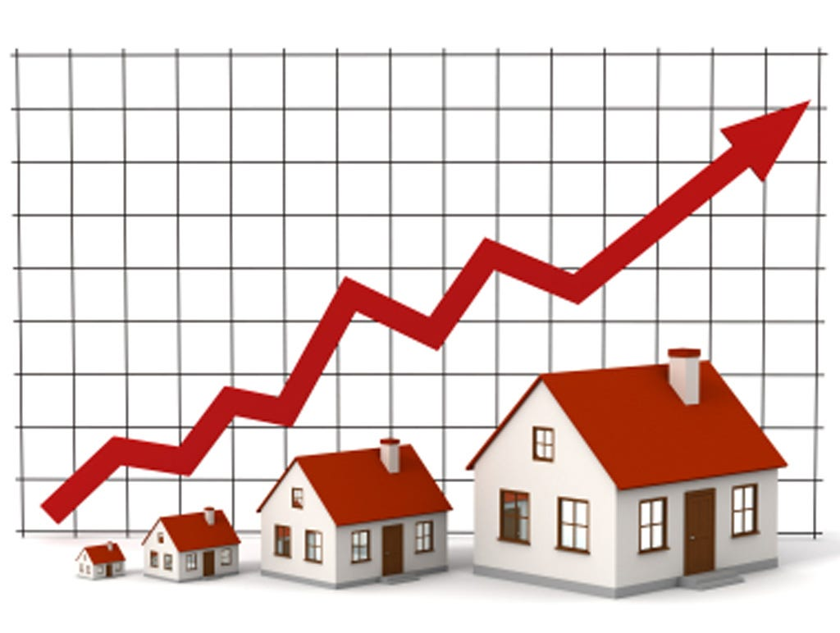
HOUSE PRICE PREDICTION
By, Ranjan Adhav.

Slide 2
Abstract
House price forecasting is an important topic of real estate. The literature attempts to derive useful knowledge from historical data of property markets. Machine learning techniques are applied to analyze historical property transactions in India to discover useful models for house buyers and sellers.Moreover, experiments demonstrate that the Multiple Linear Regression that is based on mean squared error measurement is a competitive approach.

Slide 3
Aim
These are the Parameters on which we will evaluate ourselves-
• Create an effective price prediction model
• Validate the model’s prediction accuracy
• Identify the important home price attributes which feed the model’s predictive power.

Slide 4
Data Selection
Data selection is defined as the process of determining the appropriate data type and source, as well as suitable instruments to collect data. Data selection precedes the actual practice of data collection.

Slide 5
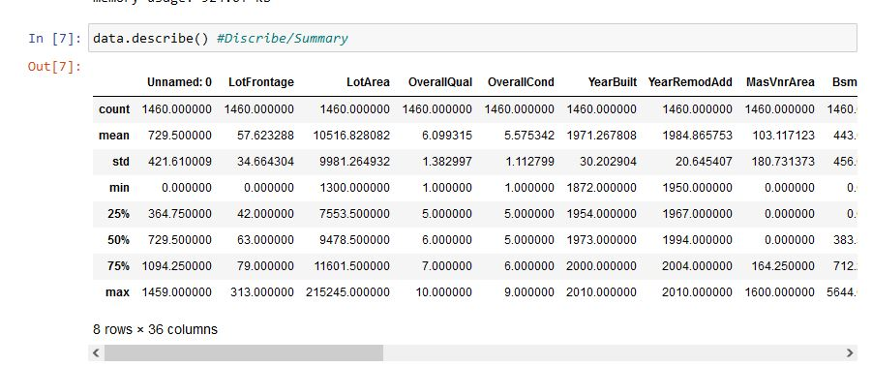
Data Describe:

Slide 6
Data visualization
Data visualization is the graphical representation of information and data. By using visual elements like charts, graphs, and maps, data visualization tools provide an accessible way to see and understand trends, outliers, and patterns in data. In the world of Big Data, data visualization tools and technologies are essential to analyse massive amounts of information and make data-driven decisions.

Slide 7
Exploratory Data Analysis
refers to the deep analysis of data so as to discover different patterns and spot anomalies. Before making inferences from data it is essential to examine all your variables.we can infer from above describe function thatthe dataset has a house where the house has 6 bedrooms , seems to be a massive house and would be interesting to know more about it as we progress. Maximum square feet is 16200 where as the minimum is 1650. we can see that the data is distributed.

Slide 8
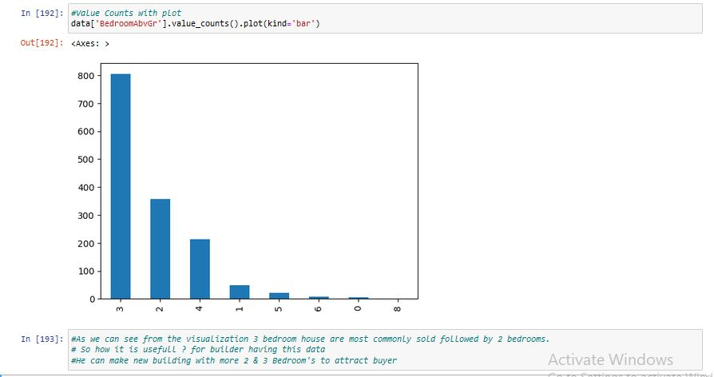
Bedroom Data:

Slide 9
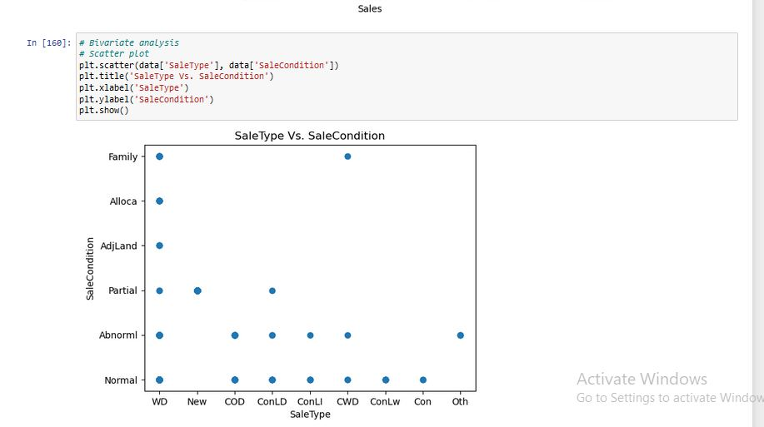
Sale Type vs Sale Condition:

Slide 10
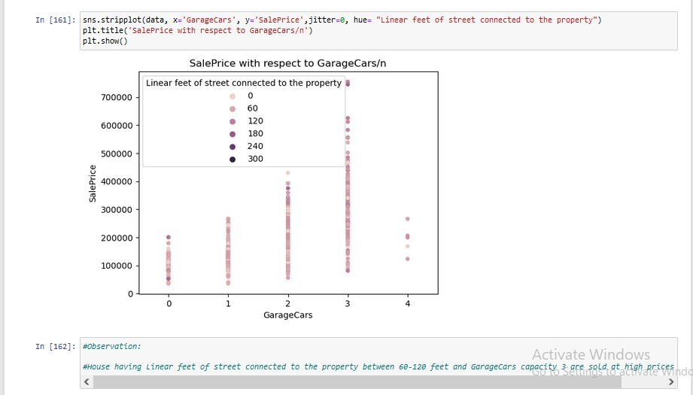
Sale Price Vs GarageCars:

Slide 11
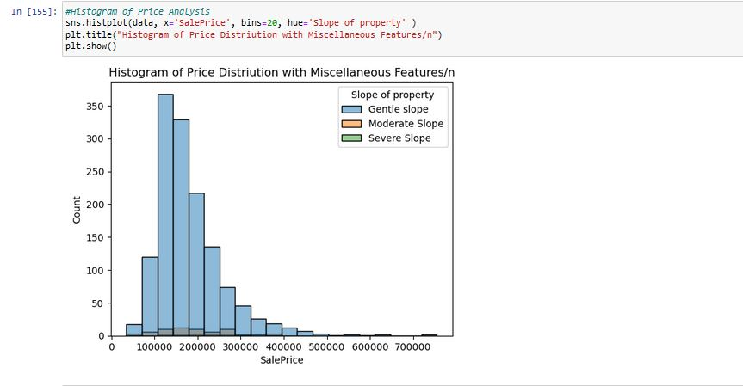
Histogram:

Slide 12
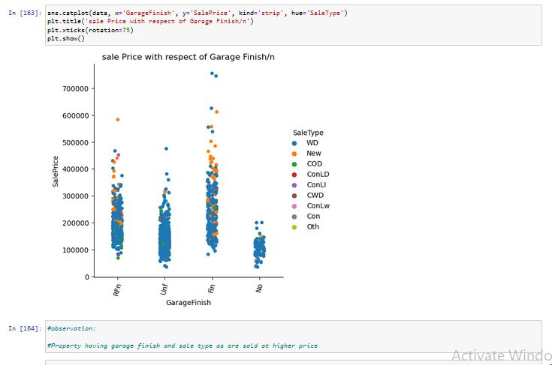
Catplot:

Slide 13
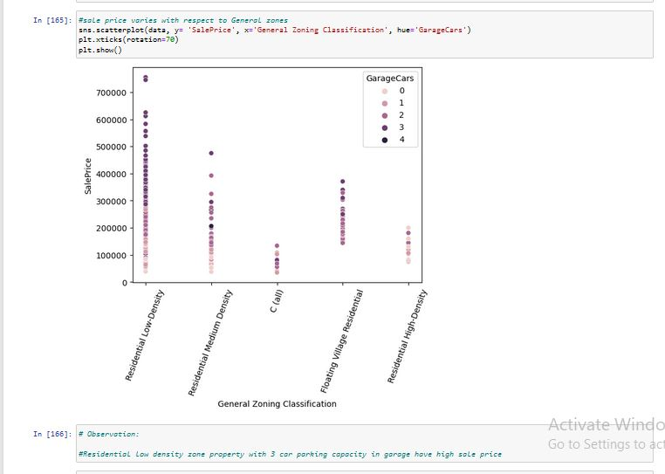
ScatterPlot:

Slide 14
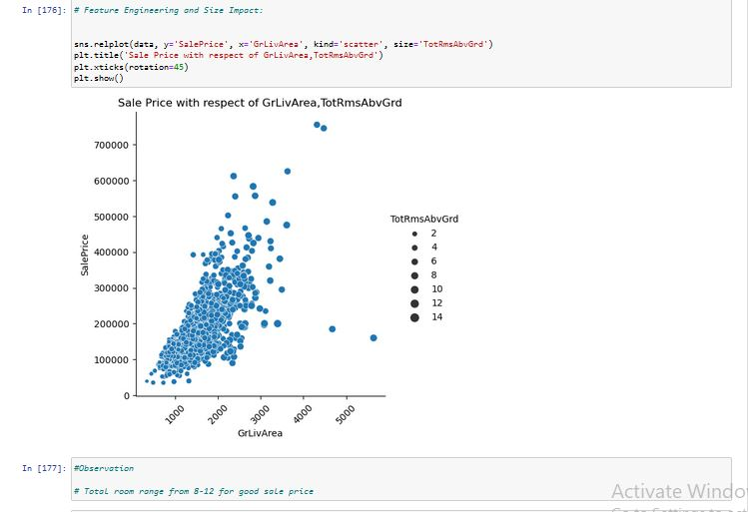
Relplot:

Slide 15
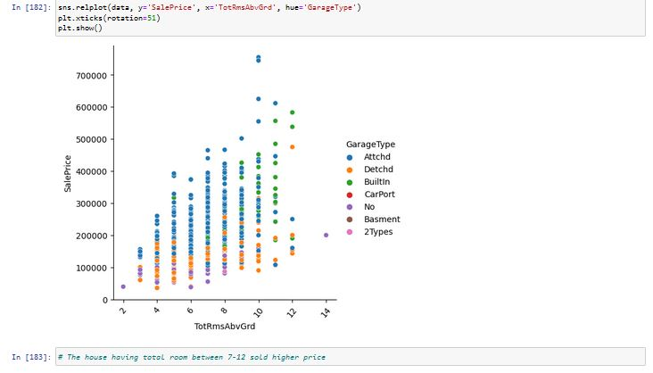

Slide 16
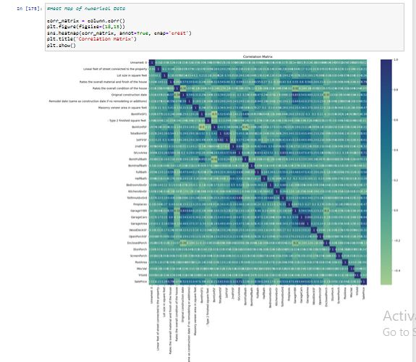
Correlation Heatmap:

Slide 17
Conclusion
So we conclude that the system that we proposed solves most of the problems that we have with the existing system.After training and testing of datasets with all models, the linear regression performs better than gradient boost regressor model. The highest accuracy score is achieved by the linear regression. So, we suggest that this regression model be used for future house price predictions. Therefore, the outcome of our project will be predicting house prices with good accuracy which can help the customer as well as developer.

Slide 18
THANK YOU.

